Slide 1

Lecture 5: A Brief Introduction to Bayesian Inference of Phylogeny
Brian R. Moore Department of Evolution & Ecology University of California, Davis
CoME, 2019

Slide 2
Outline
I. Introduction to Bayesian inference
Becoming fascinated with posteriors:
Deriving Bayes theorem
Two non-phylogenetic examples
Bayesian inference of phylogeny

Slide 3
Outline
I. Introduction to Bayesian inference
Becoming fascinated with posteriors:
Deriving Bayes theorem
Two non-phylogenetic examples
Bayesian inference of phylogeny
II. The Bayesian hard sell
What’s the deal with priors?
Learning to embrace your inner Bayesian

Slide 4
Outline
I. Introduction to Bayesian inference
Becoming fascinated with posteriors:
Deriving Bayes theorem
Two non-phylogenetic examples
Bayesian inference of phylogeny
II. The Bayesian hard sell
What’s the deal with priors?
Learning to embrace your inner Bayesian
III. Numerical algorithms for Bayesian inference
Markov-chain Monte Carlo (MCMC)
Metropolis-Hastings algorithm
Metropolis-Coupled algorithm
Summarizing posterior samples

Slide 5
Statistical Estimation of Phylogeny: An Outline
Inference Method
Data
Model
Parameter
Estimates
sequence
alignment
tree with
branch lengths
maximum likelihood
phylogeny & other model parameters
substitution
model
Bayesian inference

Slide 6
Statistical Estimation of Phylogeny: An Outline
Inference Method
Data
Model
Parameter
Estimates
sequence
alignment
tree with
branch lengths
maximum likelihood
phylogeny & other model parameters
substitution
model
Bayesian inference

Slide 7
Statistical Estimation of Phylogeny: An Outline
Inference Method
Data
Model
Parameter
Estimates
sequence
alignment
tree with
branch lengths
maximum likelihood
phylogeny & other model parameters
substitution
model
Bayesian inference

Slide 8
Outline
I. Introduction to Bayesian inference
Becoming fascinated with posteriors:
Deriving Bayes theorem
Two non-phylogenetic examples
Bayesian inference of phylogeny
II. The Bayesian hard sell
What’s the deal with priors?
Learning to embrace your inner Bayesian
III. Numerical algorithms for Bayesian inference
Markov-chain Monte Carlo (MCMC)
Metropolis-Hastings algorithm
Metropolis-Coupled algorithm
Summarizing posterior samples

Slide 9
Outline
I. Introduction to Bayesian inference
Becoming fascinated with posteriors:
Deriving Bayes theorem
Two non-phylogenetic examples
Bayesian inference of phylogeny
II. The Bayesian hard sell
What’s the deal with priors?
Learning to embrace your inner Bayesian
III. Numerical algorithms for Bayesian inference
Markov-chain Monte Carlo (MCMC)
Metropolis-Hastings algorithm
Metropolis-Coupled algorithm
Summarizing posterior samples

Slide 10
Outline
I. Introduction to Bayesian inference
Becoming fascinated with posteriors:
Deriving Bayes theorem
Two non-phylogenetic examples
Bayesian inference of phylogeny
II. The Bayesian hard sell
What’s the deal with priors?
Learning to embrace your inner Bayesian
III. Numerical algorithms for Bayesian inference
Markov-chain Monte Carlo (MCMC)
Metropolis-Hastings algorithm
Metropolis-Coupled algorithm
Summarizing posterior samples

Slide 11
Bayesian Inference
Conditional Probability
The probability of observing A given that B has occurred, Pr(A⏐B), is just the fraction of cases in which B occurs, Pr(B), that A also occurs, Pr(A,B).
Pr(A⏐B)
=
Pr(A,B)
Pr(B)

Slide 12
Bayesian Inference
Conditional Probability
The probability of observing A given that B has occurred, Pr(A⏐B), is just the fraction of cases in which B occurs, Pr(B), that A also occurs, Pr(A,B).
Pr(A⏐B)
Pr(A⏐B)
=
=
Pr(A,B)
Pr(A,B)
Pr(B)
Pr(B)
Joint Probability
The probability of observing both A and B, Pr(A,B), is therefore:

Slide 13
Bayesian Inference
Conditional Probability
The probability of observing A given that B has occurred, Pr(A⏐B), is just the fraction of cases in which B occurs, Pr(B), that A also occurs, Pr(A,B).
Pr(A⏐B)
=
Pr(A,B)
Pr(A,B)
Pr(B)
Joint Probability
The probability of observing both A and B, Pr(A,B), is therefore:
Pr(A,B)
=
Pr(B)
Pr(A⏐B)
and by the same reasoning:
Pr(A,B)
=
Pr(A)
Pr(B⏐A)
which is the probability of observing A times the probability of observing B given that A has occurred.

Slide 14
Bayesian Inference
Conditional Probability
The probability of observing A given that B has occurred, Pr(A⏐B), is just the fraction of cases in which B occurs, Pr(B), that A also occurs, Pr(A,B).
Pr(A⏐B)
=
Pr(A,B)
Pr(B)
Joint Probability
The probability of observing both A and B, Pr(A,B), is therefore:
Pr(A,B)
=
Pr(B)
Pr(A⏐B)
and by the same reasoning:
Pr(B⏐A)
Pr(A)
Pr(B⏐A)
Pr(A,B)
=
Pr(A)
which is the probability of observing A times the probability of observing B given that A has occurred.

Slide 15
Bayesian Inference
Conditional Probability
Bayes Theorem
The posterior probability of observing A given that B has occurred, Pr(A⏐B), is proportional to the product of the conditional probability of Pr(A⏐B) and the unconditional probability of A, Pr(A).
Pr(A⏐B)
=
Pr(A)
Pr(B⏐A)
Pr(B)
Joint Probability
The probability of observing both A and B, Pr(A,B), is therefore:
Pr(A,B)
=
Pr(B)
Pr(A⏐B)
and by the same reasoning:
Pr(A,B)
=
Pr(A)
Pr(B⏐A)
which is the probability of observing A times the probability of observing B given that A has occurred.

Slide 16
Bayesian Inference
Bayes Theorem
The posterior probability of observing A given that B has occurred, Pr(A⏐B), is proportional to the product of the conditional probability of Pr(A⏐B) and the unconditional probability of A, Pr(A).
Pr(A⏐B)
=
Pr(A)
Pr(B⏐A)
Pr(B)

Slide 17
Bayesian Inference
Bayes Theorem
The posterior probability of observing A given that B has occurred, Pr(A⏐B), is proportional to the product of the conditional probability of Pr(A⏐B) and the unconditional probability of A, Pr(A).
Pr(A⏐B)
=
Pr(B⏐A)
Pr(A)
Pr(B)

Slide 18
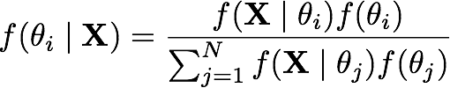
Bayesian Inference
Bayes Theorem
The posterior probability of observing A given that B has occurred, Pr(A⏐B), is proportional to the product of the conditional probability of Pr(A⏐B) and the unconditional probability of A, Pr(A).
Pr(A⏐B)
=
Pr(B⏐A)
Pr(A)
Pr(B)
unobserved outcome
observed outcome

Slide 19
Bayesian Inference
Bayes Theorem
The posterior probability of observing A given that B has occurred, Pr(A⏐B), is proportional to the product of the conditional probability of Pr(A⏐B) and the unconditional probability of A, Pr(A).
Pr(A⏐B)
=
Pr(B⏐A)
Pr(A)
Pr(B)
posterior probability
likelihood function
prior probability
marginal likelihood

Slide 20
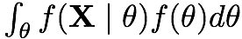
Bayesian Inference
Bayes Theorem
The posterior probability of observing A given that B has occurred, Pr(A⏐B), is proportional to the product of the conditional probability of Pr(A⏐B) and the unconditional probability of A, Pr(A).
Pr(A⏐B)
=
Pr(B⏐A)
Pr(A)
Pr(B)
posterior probability
likelihood function
prior probability
marginal likelihood

Slide 21
Outline
I. Introduction to Bayesian inference
Becoming fascinated with posteriors:
Deriving Bayes theorem
Two non-phylogenetic examples
Bayesian inference of phylogeny
II. The Bayesian hard sell
What’s the deal with priors?
Learning to embrace your inner Bayesian
III. Numerical algorithms for Bayesian inference
Markov-chain Monte Carlo (MCMC)
Metropolis-Hastings algorithm
Metropolis-Coupled algorithm
Summarizing posterior samples

Slide 22
Outline
I. Introduction to Bayesian inference
Becoming fascinated with posteriors:
Deriving Bayes theorem
Two non-phylogenetic examples
Bayesian inference of phylogeny
II. The Bayesian hard sell
What’s the deal with priors?
Learning to embrace your inner Bayesian
III. Numerical algorithms for Bayesian inference
Markov-chain Monte Carlo (MCMC)
Metropolis-Hastings algorithm
Metropolis-Coupled algorithm
Summarizing posterior samples

Slide 23
Bayesian Inference
Example: The biased-die problem
There is the possibility that the die are biased in a specific way:

Slide 24
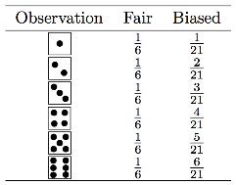
Bayesian Inference
Example: The biased-die problem
There is the possibility that the die are biased in a specific way:
90% die are fair
10% die are biased

Slide 25
Bayesian Inference
Example: The biased-die problem
There is the possibility that the die are biased in a specific way:
90% die are fair
10% die are biased
We generate some observations from a randomly selected die:
2 rolls with 4 and 6 pips

Slide 26
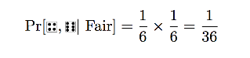
Bayesian Inference
Example: The biased-die problem
There is the possibility that the die are biased in a specific way:
90% die are fair
10% die are biased
We generate some observations from a randomly selected die:
2 rolls with 4 and 6 pips
Likelihood of the observations:

Slide 27
Bayesian Inference
Example: The biased-die problem
There is the possibility that the die are biased in a specific way:
90% die are fair
10% die are biased
We generate some observations from a randomly selected die:
2 rolls with 4 and 6 pips
Likelihood of the observations:

Slide 28
Bayesian Inference
Example: The biased-die problem
There is the possibility that the die are biased in a specific way:
90% die are fair
10% die are biased
We generate some observations from a randomly selected die:
2 rolls with 4 and 6 pips
Likelihood of the observations:

Slide 29
Bayesian Inference
Example: The biased-die problem
There is the possibility that the die are biased in a specific way:
90% die are fair
10% die are biased
We generate some observations from a randomly selected die:
2 rolls with 4 and 6 pips
Likelihood of the observations:

Slide 30
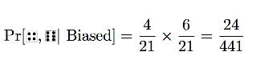
Bayesian Inference
Example: The biased-die problem
There is the possibility that the die are biased in a specific way:
90% die are fair
10% die are biased
We generate some observations from a randomly selected die:
2 rolls with 4 and 6 pips
Likelihood of the observations:

Slide 31
Bayesian Inference
Example: The biased-die problem
There is the possibility that the die are biased in a specific way:
90% die are fair
10% die are biased
We generate some observations from a randomly selected die:
2 rolls with 4 and 6 pips
Likelihood of the observations:

Slide 32
Bayesian Inference
Example: The biased-die problem
There is the possibility that the die are biased in a specific way:
90% die are fair
10% die are biased
We generate some observations from a randomly selected die:
2 rolls with 4 and 6 pips
Likelihood of the observations:

Slide 33
Bayesian Inference
Example: The biased-die problem
There is the possibility that the die are biased in a specific way:
90% die are fair
10% die are biased
We generate some observations from a randomly selected die:
2 rolls with 4 and 6 pips
Likelihood of the observations:

Slide 34
Bayesian Inference
Example: The biased-die problem
There is the possibility that the die are biased in a specific way:
90% die are fair
10% die are biased
We generate some observations from a randomly selected die:
2 rolls with 4 and 6 pips
Likelihood of the observations:
So, the observations are ~2 times more likely under the biased hypothesis

Slide 35
Bayesian Inference
Example: The biased-die problem
What is the posterior probability of the alternative hypotheses?
posterior probability

Slide 36
Bayesian Inference
Example: The biased-die problem
What is the posterior probability of the alternative hypotheses?
likelihood
posterior probability

Slide 37
Bayesian Inference
Example: The biased-die problem
What is the posterior probability of the alternative hypotheses?
likelihood
prior probability
posterior probability

Slide 38
Bayesian Inference
Example: The biased-die problem
What is the posterior probability of the alternative hypotheses?
likelihood
prior probability
posterior probability
marginal likelihood

Slide 39
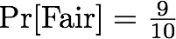
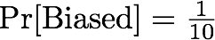
Bayesian Inference
Example: The biased-die problem
What is the posterior probability of the alternative hypotheses?
likelihood
prior probability
posterior probability
marginal likelihood
prior probabilities:

Slide 40
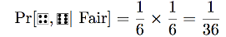
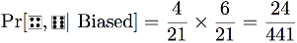
Bayesian Inference
Example: The biased-die problem
What is the posterior probability of the alternative hypotheses?
likelihood
prior probability
posterior probability
marginal likelihood
prior probabilities:
likelihoods:

Slide 41
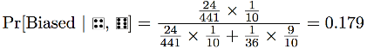
Bayesian Inference
Example: The biased-die problem
What is the posterior probability of the alternative hypotheses?
likelihood
prior probability
posterior probability
marginal likelihood
prior probabilities:
likelihoods:
posterior probability:

Slide 42
Bayesian Inference
Example: The biased-die problem
What is the posterior probability of the alternative hypotheses?
likelihood
prior probability
posterior probability
marginal likelihood
prior probabilities:
likelihoods:
posterior probability:
So, our posterior belief in the biased hypothesis is Pr = 0.179, which is an updated version of our prior belief in the biased hypothesis is Pr = 0.10

Slide 43
Bayesian Inference
Generic statistical paradigm Coin tossing
pose a substantive question
Is this a fair coin? Or, what is the probability of observing heads in a single toss?
develop a stochastic model with parameters that, if know, would answer the question
collect observations that are informative about model parameters
find the best estimate of model parameters (by some means) conditioned on (i.e., given) the data at hand

Slide 44
Bayesian Inference
Generic statistical paradigm Coin tossing
pose a substantive question
Is this a fair coin? Or, what is the probability of observing heads in a single toss?
develop a stochastic model with parameters that, if know, would answer the question
Binomial probability distribution with parameter (probability of observing heads)
collect observations that are informative about model parameters
find the best estimate of model parameters (by some means) conditioned on (i.e., given) the data at hand

Slide 45
Bayesian Inference
Generic statistical paradigm Coin tossing
pose a substantive question
Is this a fair coin? Or, what is the probability of observing heads in a single toss?
develop a stochastic model with parameters that, if know, would answer the question
Binomial probability distribution with parameter (probability of observing heads)
collect observations that are informative about model parameters
toss the coin n times and record the number of heads, x.
find the best estimate of model parameters (by some means) conditioned on (i.e., given) the data at hand

Slide 46
Bayesian Inference
Generic statistical paradigm Coin tossing
pose a substantive question
Is this a fair coin? Or, what is the probability of observing heads in a single toss?
develop a stochastic model with parameters that, if know, would answer the question
Binomial probability distribution with parameter (probability of observing heads)
collect observations that are informative about model parameters
toss the coin n times and record the number of heads, x.
find the best estimate of model parameters (by some means) conditioned on (i.e., given) the data at hand
find the best estimate of the parameter using Bayesian inference

Slide 47
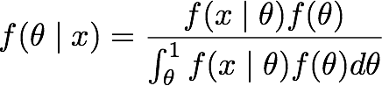
Bayesian Inference
Bayesian Inference
Example: Coin tossing
likelihood function
prior probability
posterior probability
marginal likelihood

Slide 48
Bayesian Inference
Bayesian Inference
Example: Coin tossing
likelihood function
prior probability
posterior probability
marginal likelihood

Slide 49
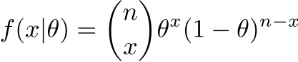
Bayesian Inference
Example: Coin tossing
We will adopt the Binomial distribution as our model of coin tossing: discrete probability distribution that has two outcomes (e.g., T/F, Y/N, H/T)
heads

Slide 50
Bayesian Inference
Example: Coin tossing
We will adopt the Binomial distribution as our model of coin tossing: discrete probability distribution that has two outcomes (e.g., T/F, Y/N, H/T)
tails

Slide 51
Bayesian Inference
Example: Coin tossing
We will adopt the Binomial distribution as our model of coin tossing: discrete probability distribution that has two outcomes (e.g., T/F, Y/N, H/T)
possible orderings of x heads in n tosses

Slide 52
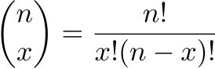
Bayesian Inference
Example: Coin tossing
We will adopt the Binomial distribution as our model of coin tossing: discrete probability distribution that has two outcomes (e.g., T/F, Y/N, H/T)
possible orderings of x heads in n tosses
This is called the Binomial coefficient, and is read 'n choose x':

Slide 53
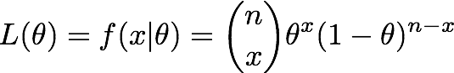
Bayesian Inference
Example: Coin tossing
We will adopt the Binomial distribution as our model of coin tossing: discrete probability distribution that has two outcomes (e.g., T/F, Y/N, H/T)
The likelihood function for the Binomial distribution:

Slide 54
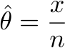
Bayesian Inference
Example: Coin tossing
We will adopt the Binomial distribution as our model of coin tossing: discrete probability distribution that has two outcomes (e.g., T/F, Y/N, H/T)
The likelihood function for the Binomial distribution:
With some algebra, we can solve for to find the MLE:

Slide 55
Bayesian Inference
Bayesian Inference
Example: Coin tossing
likelihood function
prior probability
posterior probability
marginal likelihood

Slide 56
Bayesian Inference
Bayesian Inference
Example: Coin tossing
likelihood function
prior probability
posterior probability
marginal likelihood

Slide 57
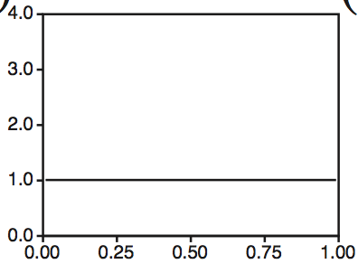
Bayesian Inference
Bayesian Inference
Example: Coin tossing
The Beta prior probability distribution:
uniform prior: alpha = beta = 1

Slide 58
Bayesian Inference
Bayesian Inference
Example: Coin tossing
The Beta prior probability distribution:
uniform prior: alpha = beta = 1
NOTE: uniform prior ≠ uninformative

Slide 59
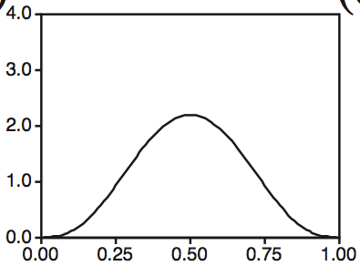
Bayesian Inference
Bayesian Inference
Example: Coin tossing
The Beta prior probability distribution:
non
uniform prior: alpha = beta = 4

Slide 60
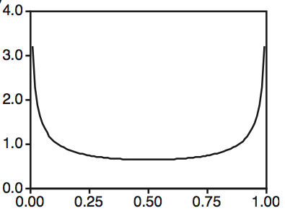
Bayesian Inference
Bayesian Inference
Example: Coin tossing
The Beta prior probability distribution:
non
uniform prior: alpha = beta = 0.5

Slide 61
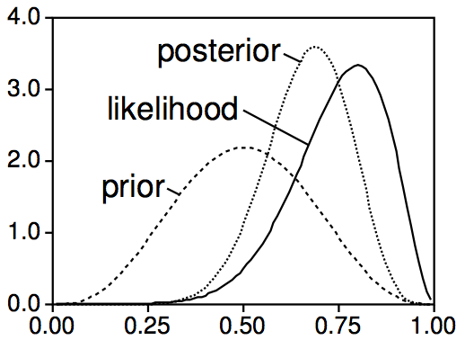
Bayesian Inference
Example: Coin tossing
The impact of the prior probability distribution on the estimated posterior probability:
posterior
likelihood
prior
x = 8 heads in n = 10 tosses

Slide 62
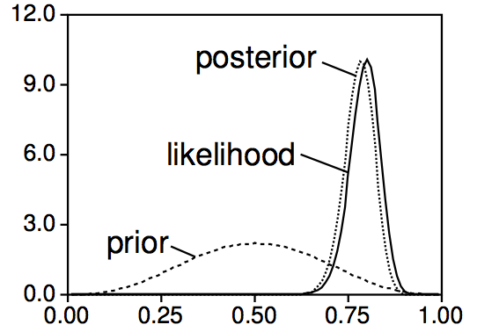
Bayesian Inference
Example: Coin tossing
The impact of the prior probability distribution on the estimated posterior probability:
posterior
likelihood
prior
x = 80 heads in n = 100 tosses
The impact of the prior decreases as the number of observations increases.

Slide 63
Outline
I. Introduction to Bayesian inference
Becoming fascinated with posteriors:
Deriving Bayes theorem
Two non-phylogenetic examples
Bayesian inference of phylogeny
II. The Bayesian hard sell
What’s the deal with priors?
Learning to embrace your inner Bayesian
III. Numerical algorithms for Bayesian inference
Markov-chain Monte Carlo (MCMC)
Metropolis-Hastings algorithm
Metropolis-Coupled algorithm
Summarizing posterior samples

Slide 64
Outline
I. Introduction to Bayesian inference
Becoming fascinated with posteriors:
Deriving Bayes theorem
Two non-phylogenetic examples
Bayesian inference of phylogeny
II. The Bayesian hard sell
What’s the deal with priors?
Learning to embrace your inner Bayesian
III. Numerical algorithms for Bayesian inference
Markov-chain Monte Carlo (MCMC)
Metropolis-Hastings algorithm
Metropolis-Coupled algorithm
Summarizing posterior samples

Slide 65
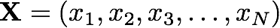
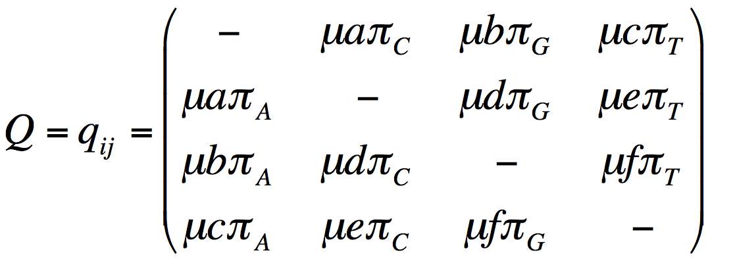
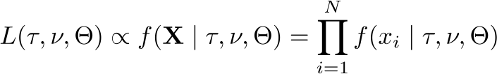
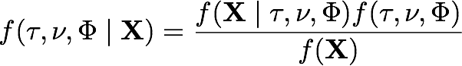
Bayesian Inference of Phylogeny (on one slide)
posterior probability
likelihood function
prior probability
I. Data
marginal likelihood
Assume an alignment, X, of N sites for S species:
II. Phylogenetic model parameters
IV. Priors on parameters
1. Tree
topology
~Uniform
branch lengths
~Dirichlet (1,...,1)
2. Model of character change
A
G
relative substitution rates
~Dirichlet (1,1,1,1,1,1)
stationary frequencies
~Dirichlet (1,1,1,1)
C
T
III. Phylogenetic likelihood function
V. Posterior Probability
prior probability

Slide 66
Bayesian Inference of Phylogeny (on one slide)
I. Data
Assume an alignment, X, of N sites for S species:
II. Phylogenetic model parameters
IV. Priors on parameters
1. Tree
topology
~Uniform
branch lengths
~Dirichlet (1,...,1)
2. Model of character change
relative substitution rates
~Dirichlet (1,1,1,1,1,1)
stationary frequencies
~Dirichlet (1,1,1,1)
III. Phylogenetic likelihood function
V. Posterior Probability

Slide 67
Outline
I. Introduction to Bayesian inference
Becoming fascinated with posteriors:
Deriving Bayes theorem
Two non-phylogenetic examples
Bayesian inference of phylogeny
II. The Bayesian hard sell
What’s the deal with priors?
Learning to embrace your inner Bayesian
III. Numerical algorithms for Bayesian inference
Markov-chain Monte Carlo (MCMC)
Metropolis-Hastings algorithm
Metropolis-Coupled algorithm
Summarizing posterior samples

Slide 68
Outline
I. Introduction to Bayesian inference
Becoming fascinated with posteriors:
Deriving Bayes theorem
Two non-phylogenetic examples
Bayesian inference of phylogeny
II. The Bayesian hard sell
What’s the deal with priors?
Learning to embrace your inner Bayesian
III. Numerical algorithms for Bayesian inference
Markov-chain Monte Carlo (MCMC)
Metropolis-Hastings algorithm
Metropolis-Coupled algorithm
Summarizing posterior samples

Slide 69
Maximum Likelihood and Bayesian Inference
vs.
What is there to disagree about?
Not much, actually:
model-based statistical inference

Slide 70
Maximum Likelihood and Bayesian Inference
vs.
What is there to disagree about?
Not much, actually:
model-based statistical inference
observations are random variables

Slide 71
Maximum Likelihood and Bayesian Inference
vs.
What is there to disagree about?
Not much, actually:
model-based statistical inference
observations are random variables
likelihood function extracts information from data to estimate parameters

Slide 72
Maximum Likelihood and Bayesian Inference
What is there to disagree about?
Not much, actually:
model-based statistical inference
observations are random variables
likelihood function extracts information from data to estimate parameters

Slide 73
Maximum Likelihood and Bayesian Inference
Lots to love about maximum-likelihood estimation
Desirable statistical properties

Slide 74
Maximum Likelihood and Bayesian Inference
Lots to love about maximum-likelihood estimation
Desirable statistical properties
consistent estimator

Slide 75
Maximum Likelihood and Bayesian Inference
Lots to love about maximum-likelihood estimation
Desirable statistical properties
consistent estimator
asymptotically efficient estimator

Slide 76
Maximum Likelihood and Bayesian Inference
Lots to love about maximum-likelihood estimation
Desirable statistical properties
consistent estimator
asymptotically efficient estimator
Explicit with respect to model assumptions

Slide 77
Maximum Likelihood and Bayesian Inference
Lots to love about maximum-likelihood estimation
Desirable statistical properties
consistent estimator
asymptotically efficient estimator
Explicit with respect to model assumptions
Convenient and objective model selection/hypothesis testing framework

Slide 78
Maximum Likelihood and Bayesian Inference
Lots to love about maximum-likelihood estimation
Desirable statistical properties
consistent estimator
asymptotically efficient estimator
Explicit with respect to model assumptions
Convenient and objective model selection/hypothesis testing framework
Some less desirable aspects of maximum-likelihood estimation
Non-intuitive meaning of likelihood

Slide 79
Maximum Likelihood and Bayesian Inference
Lots to love about maximum-likelihood estimation
Desirable statistical properties
consistent estimator
asymptotically efficient estimator
Explicit with respect to model assumptions
Convenient and objective model selection/hypothesis testing framework
Some less desirable aspects of maximum-likelihood estimation
Non-intuitive meaning of likelihood
Frequentist perspective can be awkward for some inference problems

Slide 80
Maximum Likelihood and Bayesian Inference
Lots to love about maximum-likelihood estimation
Desirable statistical properties
consistent estimator
asymptotically efficient estimator
Explicit with respect to model assumptions
Convenient and objective model selection/hypothesis testing framework
Some less desirable aspects of maximum-likelihood estimation
Non-intuitive meaning of likelihood
Frequentist perspective can be awkward for some inference problems
Less amenable to EDA scenarios

Slide 81
Maximum Likelihood and Bayesian Inference
Lots to love about maximum-likelihood estimation
Desirable statistical properties
consistent estimator
asymptotically efficient estimator
Explicit with respect to model assumptions
Convenient and objective model selection/hypothesis testing framework
Some less desirable aspects of maximum-likelihood estimation
Non-intuitive meaning of likelihood
Frequentist perspective can be awkward for some inference problems
Less amenable to EDA scenarios
Accommodating uncertainty can be less than natural

Slide 82
Maximum Likelihood and Bayesian Inference
Lots to love about maximum-likelihood estimation
Desirable statistical properties
consistent estimator
asymptotically efficient estimator
Explicit with respect to model assumptions
Convenient and objective model selection/hypothesis testing framework
Some less desirable aspects of maximum-likelihood estimation
Non-intuitive meaning of likelihood
Frequentist perspective can be awkward for some inference problems
Less amenable to EDA scenarios
Accommodating uncertainty can be less than natural

Slide 83
Maximum Likelihood and Bayesian Inference
Maximum-likelihood perspective on parameters:
Data are random variables, but the parameters are fixed

Slide 84
Maximum Likelihood and Bayesian Inference
Maximum-likelihood perspective on parameters:
Data are random variables, but the parameters are fixed
Bayesian perspective on parameters:
Data are random variables, and so are the model parameters

Slide 85
Maximum Likelihood and Bayesian Inference
Maximum-likelihood perspective on parameters:
Data are random variables, but the parameters are fixed
Bayesian perspective on parameters:
Data are random variables, and so are the model parameters
If we treat the parameters are random variables, what do we have to specify?

Slide 86
Bayesian Inference
A priori…
We usually (i.e., always) have prior beliefs, so why not be explicit about it?
this is consistent with making assumptions clear (model-based inference)

Slide 87
Bayesian Inference
A priori…
We usually (i.e., always) have prior beliefs, so why not be explicit about it?
this is consistent with making assumptions clear (model-based inference)
When relevant prior information is available, it can be naturally incorporated
this is consistent with the way we behave as rational beings

Slide 88
Bayesian Inference
A priori…
We usually (i.e., always) have prior beliefs, so why not be explicit about it?
this is consistent with making assumptions clear (model-based inference)
When relevant prior information is available, it can be naturally incorporated
this is consistent with the way we behave as rational beings
It can be non-trivial to specify our prior beliefs as probability distributions
we might attempt to define vague priors in some cases

Slide 89
Bayesian Inference
A priori…
We usually (i.e., always) have prior beliefs, so why not be explicit about it?
this is consistent with making assumptions clear (model-based inference)
When relevant prior information is available, it can be naturally incorporated
this is consistent with the way we behave as rational beings
It can be non-trivial to specify our prior beliefs as probability distributions
we might attempt to define vague priors in some cases
we can (and should) assess the impact of our prior assumptions

Slide 90
Bayesian Inference
A priori…
We usually (i.e., always) have prior beliefs, so why not be explicit about it?
this is consistent with making assumptions clear (model-based inference)
When relevant prior information is available, it can be naturally incorporated
this is consistent with the way we behave as rational beings
It can be non-trivial to specify our prior beliefs as probability distributions
we might attempt to define vague priors in some cases
we can (and should) assess the impact of our prior assumptions
Concerns about the prior sensitivity are largely philosophical
the posterior is typically dominated by the likelihood function

Slide 91
Bayesian Inference
A priori…
We usually (i.e., always) have prior beliefs, so why not be explicit about it?
this is consistent with making assumptions clear (model-based inference)
When relevant prior information is available, it can be naturally incorporated
this is consistent with the way we behave as rational beings
It can be non-trivial to specify our prior beliefs as probability distributions
we might attempt to define vague priors in some cases
we can (and should) assess the impact of our prior assumptions
Concerns about the prior sensitivity are largely philosophical
the posterior is typically dominated by the likelihood function
when this is not the case, the ability to detect prior sensitivity is a good thing!

Slide 92


Slide 93
Outline
I. Introduction to Bayesian inference
Becoming fascinated with posteriors:
Deriving Bayes theorem
Two non-phylogenetic examples
Bayesian inference of phylogeny
II. The Bayesian hard sell
What’s the deal with priors?
Learning to embrace your inner Bayesian
III. Numerical algorithms for Bayesian inference
Markov-chain Monte Carlo (MCMC)
Metropolis-Hastings algorithm
Metropolis-Coupled algorithm
Summarizing posterior samples

Slide 94
Outline
I. Introduction to Bayesian inference
Becoming fascinated with posteriors:
Deriving Bayes theorem
Two non-phylogenetic examples
Bayesian inference of phylogeny
II. The Bayesian hard sell
What’s the deal with priors?
Learning to embrace your inner Bayesian
III. Numerical algorithms for Bayesian inference
Markov-chain Monte Carlo (MCMC)
Metropolis-Hastings algorithm
Metropolis-Coupled algorithm
Summarizing posterior samples

Slide 95
Bayesian Inference of Phylogeny (on one slide)
I. Data
Assume an alignment, X, of N sites for S species:
II. Phylogenetic model parameters
IV. Priors on parameters
1. Tree
topology
~Uniform
branch lengths
~Dirichlet (1,...,1)
2. Model of character change
relative substitution rates
~Dirichlet (1,1,1,1,1,1)
stationary frequencies
~Dirichlet (1,1,1,1)
III. Phylogenetic likelihood function
V. Posterior Probability
prior probability

Slide 96
Bayesian Inference of Phylogeny (on one slide)
posterior probability
likelihood function
prior probability
I. Data
marginal likelihood
Assume an alignment, X, of N sites for S species:
II. Phylogenetic model parameters
IV. Priors on parameters
1. Tree
topology
~Uniform
branch lengths
~Dirichlet (1,...,1)
2. Model of character change
A
G
relative substitution rates
~Dirichlet (1,1,1,1,1,1)
stationary frequencies
~Dirichlet (1,1,1,1)
C
T
III. Phylogenetic likelihood function
V. Posterior Probability

Slide 97
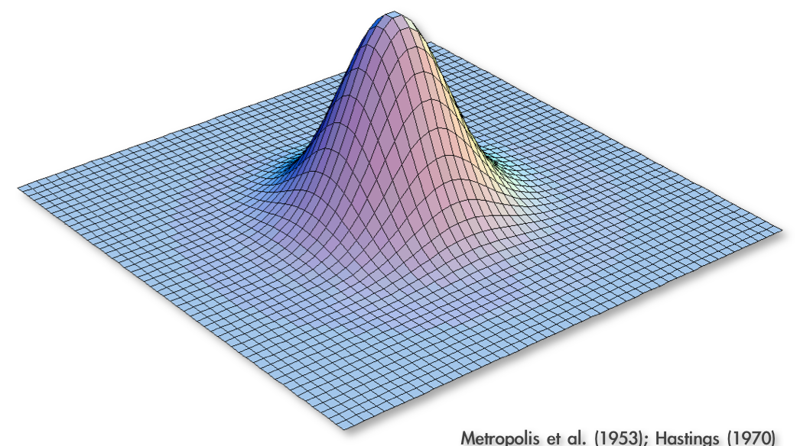
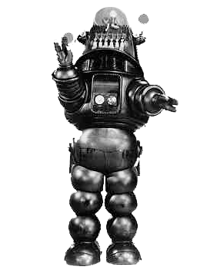
Approximating the Joint Posterior Probability Density using MCMC
Programming our MCMC robot...
Our robot parachutes into a random location in the joint posterior density
and will explore parameter space by following these simple rules:
Metropolis et al. (1953); Hastings (1970)

Slide 98
Approximating the Joint Posterior Probability Density using MCMC
Programming our MCMC robot...
Our robot parachutes into a random location in the joint posterior density
and will explore parameter space by following these simple rules:
Metropolis et al. (1953); Hastings (1970)

Slide 99
Approximating the Joint Posterior Probability Density using MCMC
Programming our MCMC robot...
Our robot parachutes into a random location in the joint posterior density
and will explore parameter space by following these simple rules:
1. If the proposed step will take the robot uphill, it automatically takes the step
Pr[Accept] = 1
Metropolis et al. (1953); Hastings (1970)

Slide 100
Approximating the Joint Posterior Probability Density using MCMC
Programming our MCMC robot...
Our robot parachutes into a random location in the joint posterior density
and will explore parameter space by following these simple rules:
1. If the proposed step will take the robot uphill, it automatically takes the step
Pr[Accept] = 1
Metropolis et al. (1953); Hastings (1970)

Slide 101
Approximating the Joint Posterior Probability Density using MCMC
Programming our MCMC robot...
Our robot parachutes into a random location in the joint posterior density
and will explore parameter space by following these simple rules:
1. If the proposed step will take the robot uphill, it automatically takes the step
2. If the proposed step will take the robot downhill, it divides the elevation of the proposed location by the current location, and it only takes the step if the quotient is less than a uniform random variable, Uniform[0,1]
Metropolis et al. (1953); Hastings (1970)

Slide 102
Approximating the Joint Posterior Probability Density using MCMC
Programming our MCMC robot...
Our robot parachutes into a random location in the joint posterior density
and will explore parameter space by following these simple rules:
1. If the proposed step will take the robot uphill, it automatically takes the step
2. If the proposed step will take the robot downhill, it divides the elevation of the proposed location by the current location, and it only takes the step if the quotient is less than a uniform random variable, Uniform[0,1]
Pr[Accept] = new height
old height
Metropolis et al. (1953); Hastings (1970)

Slide 103
Approximating the Joint Posterior Probability Density using MCMC
Programming our MCMC robot...
Our robot parachutes into a random location in the joint posterior density
and will explore parameter space by following these simple rules:
1. If the proposed step will take the robot uphill, it automatically takes the step
2. If the proposed step will take the robot downhill, it divides the elevation of the proposed location by the current location, and it only takes the step if the quotient is less than a uniform random variable, Uniform[0,1]
3. The proposal distribution is symmetrical, so Pr[A B] = Pr[B A]
Pr[Accept] = new height
old height
Metropolis et al. (1953); Hastings (1970)

Slide 104
Approximating the Joint Posterior Probability Density using MCMC
Programming our MCMC robot...
Our robot parachutes into a random location in the joint posterior density
and will explore parameter space by following these simple rules:
1. If the proposed step will take the robot uphill, it automatically takes the step
2. If the proposed step will take the robot downhill, it divides the elevation of the proposed location by the current location, and it only takes the step if the quotient is less than a uniform random variable, Uniform[0,1]
3. The proposal distribution is symmetrical, so Pr[A B] = Pr[B A]
Metropolis et al. (1953); Hastings (1970)

Slide 105
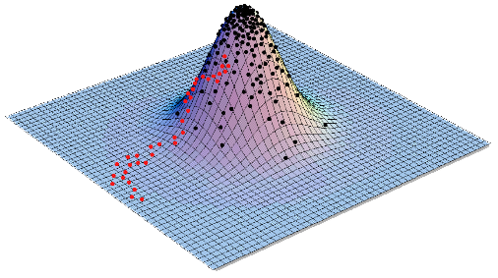
Approximating the Joint Posterior Probability Density using MCMC
Programming our MCMC robot...
Our robot parachutes into a random location in the joint posterior density
and will explore parameter space by following these simple rules:
1. If the proposed step will take the robot uphill, it automatically takes the step
2. If the proposed step will take the robot downhill, it divides the elevation of the proposed location by the current location, and it only takes the step if the quotient is less than a uniform random variable, Uniform[0,1]
3. The proposal distribution is symmetrical, so Pr[A B] = Pr[B A]
Metropolis et al. (1953); Hastings (1970)

Slide 106
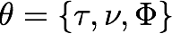
Approximating the Joint Posterior Probability Density using MCMC
The Metropolis-Hastings algorithm
1. Initialize the chain with some random values for all parameters, including the tree with branch lengths,
Metropolis et al. (1953); Hastings (1970)

Slide 107
Approximating the Joint Posterior Probability Density using MCMC
The Metropolis-Hastings algorithm
1. Initialize the chain with some random values for all parameters, including the tree with branch lengths,
2. Select a parameter to update (alter) according to the proposal probabilities
Metropolis et al. (1953); Hastings (1970)

Slide 108
Approximating the Joint Posterior Probability Density using MCMC
The Metropolis-Hastings algorithm
1. Initialize the chain with some random values for all parameters, including the tree with branch lengths,
2. Select a parameter to update (alter) according to the proposal probabilities
parameter
prior distribution
proposal weights
pi ~ dnDirichlet(pi_prior)
#moves for base frequencies
moves[++mi] = mvSimplexElementScale(pi, alpha=10.0, tune=true, weight=1.0)
er ~ dnDirichlet(er_prior)
#moves for exchangeability rates
moves[++mi] = mvSimplexElementScale(er, alpha=10.0, tune=true, weight=1.0)
alpha ~ dnUnif( alpha_prior_min, alpha_prior_max )
#moves for alpha-shape parameter
moves[++mi] = mvScale(alpha, lambda=0.8, tune=true, weight=1.0)
Metropolis et al. (1953); Hastings (1970)

Slide 109
Approximating the Joint Posterior Probability Density using MCMC
The Metropolis-Hastings algorithm
1. Initialize the chain with some random values for all parameters, including the tree with branch lengths,
2. Select a parameter to update (alter) according to the proposal probabilities
parameter
prior distribution
proposal weights
pi ~ dnDirichlet(pi_prior)
#moves for base frequencies
moves[++mi] = mvSimplexElementScale(pi, alpha=10.0, tune=true, weight=2.0)
er ~ dnDirichlet(er_prior)
#moves for exchangeability rates
moves[++mi] = mvSimplexElementScale(er, alpha=10.0, tune=true, weight=2.0)
alpha ~ dnUnif( alpha_prior_min, alpha_prior_max )
#moves for alpha-shape parameter
moves[++mi] = mvScale(alpha, lambda=0.8, tune=true, weight=2.0)
Running MCMC simulation
The simulator uses 48 different moves in a random move schedule with 96
moves per iteration
Metropolis et al. (1953); Hastings (1970)

Slide 110
Approximating the Joint Posterior Probability Density using MCMC
The Metropolis-Hastings algorithm
1. Initialize the chain with some random values for all parameters, including the tree with branch lengths,
2. Select a parameter to update (alter) according to the proposal probabilities
parameter
prior distribution
proposal weights
pi ~ dnDirichlet(pi_prior)
#moves for base frequencies
moves[++mi] = mvSimplexElementScale(pi, alpha=10.0, tune=true, weight=4.0)
er ~ dnDirichlet(er_prior)
#moves for exchangeability rates
moves[++mi] = mvSimplexElementScale(er, alpha=10.0, tune=true, weight=4.0)
alpha ~ dnUnif( alpha_prior_min, alpha_prior_max )
#moves for alpha-shape parameter
moves[++mi] = mvScale(alpha, lambda=0.8, tune=true, weight=4.0)
Running MCMC simulation
The simulator uses 48 different moves in a random move schedule with 192
moves per iteration
Metropolis et al. (1953); Hastings (1970)

Slide 111
Approximating the Joint Posterior Probability Density using MCMC
The Metropolis-Hastings algorithm
1. Initialize the chain with some random values for all parameters, including the tree with branch lengths,
2. Select a parameter to update (alter) according to the proposal probabilities
parameter
prior distribution
proposal weights
pi ~ dnDirichlet(pi_prior)
#moves for base frequencies
moves[++mi] = mvSimplexElementScale(pi, alpha=10.0, tune=true, weight=1.0)
er ~ dnDirichlet(er_prior)
#moves for exchangeability rates
moves[++mi] = mvSimplexElementScale(er, alpha=10.0, tune=true, weight=1.0)
alpha ~ dnUnif( alpha_prior_min, alpha_prior_max )
#moves for alpha-shape parameter
moves[++mi] = mvScale(alpha, lambda=0.8, tune=true, weight=4.0)
Metropolis et al. (1953); Hastings (1970)

Slide 112
Approximating the Joint Posterior Probability Density using MCMC
The Metropolis-Hastings algorithm
1. Initialize the chain with some random values for all parameters, including the tree with branch lengths,
2. Select a parameter to update (alter) according to the proposal probabilities
3. Propose a new value, , for the selected parameter via the proposal mechanism:
each parameter has a prior probability distribution of a specific form (uniform, etc.)
each prior probability distribution has one or more proposal mechanisms
Metropolis et al. (1953); Hastings (1970)

Slide 113
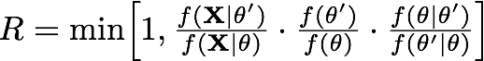
Approximating the Joint Posterior Probability Density using MCMC
The Metropolis-Hastings algorithm
1. Initialize the chain with some random values for all parameters, including the tree with branch lengths,
2. Select a parameter to update (alter) according to the proposal probabilities
3. Propose a new value, , for the selected parameter via the proposal mechanism:
each parameter has a prior probability distribution of a specific form (uniform, etc.)
each prior probability distribution has one or more proposal mechanisms
4. Calculate the probability of accepting the proposed change:
likelihood ratio
prior ratio
proposal ratio
Metropolis et al. (1953); Hastings (1970)

Slide 114
Approximating the Joint Posterior Probability Density using MCMC
The Metropolis-Hastings algorithm
1. Initialize the chain with some random values for all parameters, including the tree with branch lengths,
2. Select a parameter to update (alter) according to the proposal probabilities
3. Propose a new value, , for the selected parameter via the proposal mechanism:
each parameter has a prior probability distribution of a specific form (uniform, etc.)
each prior probability distribution has one or more proposal mechanisms
4. Calculate the probability of accepting the proposed change:
likelihood function
prior probability
posterior probability
marginal likelihood
Metropolis et al. (1953); Hastings (1970)

Slide 115
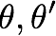
Approximating the Joint Posterior Probability Density using MCMC
The Metropolis-Hastings algorithm
1. Initialize the chain with some random values for all parameters, including the tree with branch lengths,
2. Select a parameter to update (alter) according to the proposal probabilities
3. Propose a new value, , for the selected parameter via the proposal mechanism:
each parameter has a prior probability distribution of a specific form (uniform, etc.)
each prior probability distribution has one or more proposal mechanisms
4. Calculate the probability of accepting the proposed change:
How do we calculate the likelihood for a given parameter value, ?
likelihood ratio
prior ratio
proposal ratio
Metropolis et al. (1953); Hastings (1970)

Slide 116
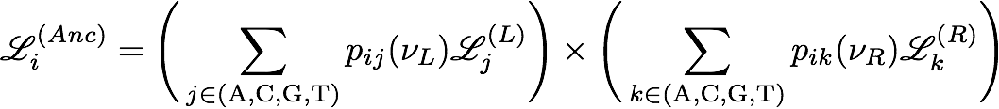
How Do We Calculate Site Likelihoods?
The Felsenstein Pruning Algorithm
Then we need to repeat the entire process for each of the more inclusive nodes toward the root, where the conditional likelihoods of the tips are first recorded...

Slide 117
How Do We Calculate Site Likelihoods?
The Felsenstein Pruning Algorithm
Then we need to repeat the entire process for each of the more inclusive nodes toward the root, where the conditional likelihoods of the tips are first recorded...

Slide 118
How Do We Calculate Site Likelihoods?
The Felsenstein Pruning Algorithm
Then we need to repeat the entire process for each of the more inclusive nodes toward the root, where the conditional likelihoods of the tips are first recorded...

Slide 119
How Do We Calculate Site Likelihoods?
The Felsenstein Pruning Algorithm
Then we need to repeat the entire process for each of the more inclusive nodes toward the root, where the conditional likelihoods of the tips are first recorded...

Slide 120
How Do We Calculate Site Likelihoods?
The Felsenstein Pruning Algorithm
Then we need to repeat the entire process for each of the more inclusive nodes toward the root, where the conditional likelihoods of the tips are first recorded...

Slide 121
How Do We Calculate Site Likelihoods?
The Felsenstein Pruning Algorithm
Then we need to repeat the entire process for each of the more inclusive nodes toward the root, where the conditional likelihoods of the tips are first recorded...

Slide 122
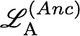
How Do We Calculate Site Likelihoods?
The Felsenstein Pruning Algorithm
Then we need to repeat the entire process for each of the more inclusive nodes toward the root, where the conditional likelihoods of the tips are first recorded, then we loop over the internal nodes in a post-order traversal…

Slide 123
How Do We Calculate Site Likelihoods?
The Felsenstein Pruning Algorithm
Then we need to repeat the entire process for each of the more inclusive nodes toward the root, where the conditional likelihoods of the tips are first recorded, then we loop over the internal nodes in a post-order traversal…

Slide 124
How Do We Calculate Site Likelihoods?
The Felsenstein Pruning Algorithm
Then we need to repeat the entire process for each of the more inclusive nodes toward the root, where the conditional likelihoods of the tips are first recorded, then we loop over the internal nodes in a post-order traversal…

Slide 125
How Do We Calculate Site Likelihoods?
The Felsenstein Pruning Algorithm
Then we need to repeat the entire process for each of the more inclusive nodes toward the root, where the conditional likelihoods of the tips are first recorded, then we loop over the internal nodes in a post-order traversal…

Slide 126
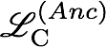
How Do We Calculate Site Likelihoods?
The Felsenstein Pruning Algorithm
Then we need to repeat the entire process for each of the more inclusive nodes toward the root, where the conditional likelihoods of the tips are first recorded, then we loop over the internal nodes in a post-order traversal…

Slide 127
How Do We Calculate Site Likelihoods?
The Felsenstein Pruning Algorithm
Then we need to repeat the entire process for each of the more inclusive nodes toward the root, where the conditional likelihoods of the tips are first recorded, then we loop over the internal nodes in a post-order traversal…

Slide 128
How Do We Calculate Site Likelihoods?
The Felsenstein Pruning Algorithm
Then we need to repeat the entire process for each of the more inclusive nodes toward the root, where the conditional likelihoods of the tips are first recorded, then we loop over the internal nodes in a post-order traversal…

Slide 129
How Do We Calculate Site Likelihoods?
The Felsenstein Pruning Algorithm
Then we need to repeat the entire process for each of the more inclusive nodes toward the root, where the conditional likelihoods of the tips are first recorded, then we loop over the internal nodes in a post-order traversal…

Slide 130
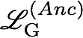
How Do We Calculate Site Likelihoods?
The Felsenstein Pruning Algorithm
Then we need to repeat the entire process for each of the more inclusive nodes toward the root, where the conditional likelihoods of the tips are first recorded, then we loop over the internal nodes in a post-order traversal…

Slide 131
How Do We Calculate Site Likelihoods?
The Felsenstein Pruning Algorithm
Then we need to repeat the entire process for each of the more inclusive nodes toward the root, where the conditional likelihoods of the tips are first recorded, then we loop over the internal nodes in a post-order traversal…

Slide 132
How Do We Calculate Site Likelihoods?
The Felsenstein Pruning Algorithm
Then we need to repeat the entire process for each of the more inclusive nodes toward the root, where the conditional likelihoods of the tips are first recorded, then we loop over the internal nodes in a post-order traversal…

Slide 133
How Do We Calculate Site Likelihoods?
The Felsenstein Pruning Algorithm
Then we need to repeat the entire process for each of the more inclusive nodes toward the root, where the conditional likelihoods of the tips are first recorded, then we loop over the internal nodes in a post-order traversal…

Slide 134
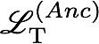
How Do We Calculate Site Likelihoods?
The Felsenstein Pruning Algorithm
Then we need to repeat the entire process for each of the more inclusive nodes toward the root, where the conditional likelihoods of the tips are first recorded, then we loop over the internal nodes in a post-order traversal…

Slide 135
How Do We Calculate Site Likelihoods?
The Felsenstein Pruning Algorithm
Then we need to repeat the entire process for each of the more inclusive nodes toward the root, where the conditional likelihoods of the tips are first recorded, then we loop over the internal nodes in a post-order traversal…

Slide 136
How Do We Calculate Site Likelihoods?
The Felsenstein Pruning Algorithm
Then we need to repeat the entire process for each of the more inclusive nodes toward the root, where the conditional likelihoods of the tips are first recorded, then we loop over the internal nodes in a post-order traversal…

Slide 137
How Do We Calculate Site Likelihoods?
The Felsenstein Pruning Algorithm
Then we need to repeat the entire process for each of the more inclusive nodes toward the root, where the conditional likelihoods of the tips are first recorded, then we loop over the internal nodes in a post-order traversal…

Slide 138
How Do We Calculate Site Likelihoods?
The Felsenstein Pruning Algorithm
Then we need to repeat the entire process for each of the more inclusive nodes toward the root, where the conditional likelihoods of the tips are first recorded, then we loop over the internal nodes in a post-order traversal…

Slide 139
How Do We Calculate Site Likelihoods?
The Felsenstein Pruning Algorithm
Then we need to repeat the entire process for each of the more inclusive nodes toward the root, where the conditional likelihoods of the tips are first recorded, then we loop over the internal nodes in a post-order traversal…

Slide 140
How Do We Calculate Site Likelihoods?
The Felsenstein Pruning Algorithm
Then we need to repeat the entire process for each of the more inclusive nodes toward the root, where the conditional likelihoods of the tips are first recorded, then we loop over the internal nodes in a post-order traversal…

Slide 141
How Do We Calculate Site Likelihoods?
The Felsenstein Pruning Algorithm
Then we need to repeat the entire process for each of the more inclusive nodes toward the root, where the conditional likelihoods of the tips are first recorded, then we loop over the internal nodes in a post-order traversal…

Slide 142
How Do We Calculate Site Likelihoods?
The Felsenstein Pruning Algorithm
Then we need to repeat the entire process for each of the more inclusive nodes toward the root, where the conditional likelihoods of the tips are first recorded, then we loop over the internal nodes in a post-order traversal…

Slide 143
How Do We Calculate Site Likelihoods?
The Felsenstein Pruning Algorithm
Then we need to repeat the entire process for each of the more inclusive nodes toward the root, where the conditional likelihoods of the tips are first recorded, then we loop over the internal nodes in a post-order traversal…

Slide 144
How Do We Calculate Site Likelihoods?
The Felsenstein Pruning Algorithm
Then we need to repeat the entire process for each of the more inclusive nodes toward the root, where the conditional likelihoods of the tips are first recorded, then we loop over the internal nodes in a post-order traversal…

Slide 145
How Do We Calculate Site Likelihoods?
The Felsenstein Pruning Algorithm
Then we need to repeat the entire process for each of the more inclusive nodes toward the root, where the conditional likelihoods of the tips are first recorded, then we loop over the internal nodes in a post-order traversal…

Slide 146
How Do We Calculate Site Likelihoods?
The Felsenstein Pruning Algorithm
Then we need to repeat the entire process for each of the more inclusive nodes toward the root, where the conditional likelihoods of the tips are first recorded, then we loop over the internal nodes in a post-order traversal…

Slide 147
How Do We Calculate Site Likelihoods?
The Felsenstein Pruning Algorithm
Then we need to repeat the entire process for each of the more inclusive nodes toward the root, where the conditional likelihoods of the tips are first recorded, then we loop over the internal nodes in a post-order traversal…

Slide 148
How Do We Calculate Site Likelihoods?
The Felsenstein Pruning Algorithm
Then we need to repeat the entire process for each of the more inclusive nodes toward the root, where the conditional likelihoods of the tips are first recorded, then we loop over the internal nodes in a post-order traversal…

Slide 149
How Do We Calculate Site Likelihoods?
The Felsenstein Pruning Algorithm
Then we need to repeat the entire process for each of the more inclusive nodes toward the root, where the conditional likelihoods of the tips are first recorded, then we loop over the internal nodes in a post-order traversal…

Slide 150
How Do We Calculate Site Likelihoods?
The Felsenstein Pruning Algorithm
Then we need to repeat the entire process for each of the more inclusive nodes toward the root, where the conditional likelihoods of the tips are first recorded, then we loop over the internal nodes in a post-order traversal…

Slide 151
How Do We Calculate Site Likelihoods?
The Felsenstein Pruning Algorithm
Then we need to repeat the entire process for each of the more inclusive nodes toward the root, where the conditional likelihoods of the tips are first recorded, then we loop over the internal nodes in a post-order traversal…

Slide 152
How Do We Calculate Site Likelihoods?
The Felsenstein Pruning Algorithm
Then we need to repeat the entire process for each of the more inclusive nodes toward the root, where the conditional likelihoods of the tips are first recorded, then we loop over the internal nodes in a post-order traversal…

Slide 153
How Do We Calculate Site Likelihoods?
The Felsenstein Pruning Algorithm
Then we need to repeat the entire process for each of the more inclusive nodes toward the root, where the conditional likelihoods of the tips are first recorded, then we loop over the internal nodes in a post-order traversal…

Slide 154
How Do We Calculate Site Likelihoods?
The Felsenstein Pruning Algorithm
Then we need to repeat the entire process for each of the more inclusive nodes toward the root, where the conditional likelihoods of the tips are first recorded, then we loop over the internal nodes in a post-order traversal…

Slide 155
How Do We Calculate Site Likelihoods?
The Felsenstein Pruning Algorithm
Then we need to repeat the entire process for each of the more inclusive nodes toward the root, where the conditional likelihoods of the tips are first recorded, then we loop over the internal nodes in a post-order traversal…

Slide 156
How Do We Calculate Site Likelihoods?
The Felsenstein Pruning Algorithm
Then we need to repeat the entire process for each of the more inclusive nodes toward the root, where the conditional likelihoods of the tips are first recorded, then we loop over the internal nodes in a post-order traversal…

Slide 157
How Do We Calculate Site Likelihoods?
The Felsenstein Pruning Algorithm
Then we need to repeat the entire process for each of the more inclusive nodes toward the root, where the conditional likelihoods of the tips are first recorded, then we loop over the internal nodes in a post-order traversal…

Slide 158
How Do We Calculate Site Likelihoods?
The Felsenstein Pruning Algorithm
Then we need to repeat the entire process for each of the more inclusive nodes toward the root, where the conditional likelihoods of the tips are first recorded, then we loop over the internal nodes in a post-order traversal…

Slide 159
How Do We Calculate Site Likelihoods?
The Felsenstein Pruning Algorithm
Then we need to repeat the entire process for each of the more inclusive nodes toward the root, where the conditional likelihoods of the tips are first recorded, then we loop over the internal nodes in a post-order traversal…

Slide 160
How Do We Calculate Site Likelihoods?
The Felsenstein Pruning Algorithm
Then we need to repeat the entire process for each of the more inclusive nodes toward the root, where the conditional likelihoods of the tips are first recorded, then we loop over the internal nodes in a post-order traversal…

Slide 161
How Do We Calculate Site Likelihoods?
The Felsenstein Pruning Algorithm
Then we need to repeat the entire process for each of the more inclusive nodes toward the root, where the conditional likelihoods of the tips are first recorded, then we loop over the internal nodes in a post-order traversal…

Slide 162
How Do We Calculate Site Likelihoods?
The Felsenstein Pruning Algorithm
Then we need to repeat the entire process for each of the more inclusive nodes toward the root, where the conditional likelihoods of the tips are first recorded, then we loop over the internal nodes in a post-order traversal…

Slide 163
How Do We Calculate Site Likelihoods?
The Felsenstein Pruning Algorithm
Then we need to repeat the entire process for each of the more inclusive nodes toward the root, where the conditional likelihoods of the tips are first recorded, then we loop over the internal nodes in a post-order traversal…

Slide 164
How Do We Calculate Site Likelihoods?
The Felsenstein Pruning Algorithm
Then we need to repeat the entire process for each of the more inclusive nodes toward the root, where the conditional likelihoods of the tips are first recorded, then we loop over the internal nodes in a post-order traversal…

Slide 165
How Do We Calculate Site Likelihoods?
The Felsenstein Pruning Algorithm
Then we need to repeat the entire process for each of the more inclusive nodes toward the root, where the conditional likelihoods of the tips are first recorded, then we loop over the internal nodes in a post-order traversal…

Slide 166
How Do We Calculate Site Likelihoods?
The Felsenstein Pruning Algorithm
Then we need to repeat the entire process for each of the more inclusive nodes toward the root, where the conditional likelihoods of the tips are first recorded, then we loop over the internal nodes in a post-order traversal…

Slide 167
How Do We Calculate Site Likelihoods?
The Felsenstein Pruning Algorithm
Then we need to repeat the entire process for each of the more inclusive nodes toward the root, where the conditional likelihoods of the tips are first recorded, then we loop over the internal nodes in a post-order traversal…

Slide 168
How Do We Calculate Site Likelihoods?
The Felsenstein Pruning Algorithm
Then we need to repeat the entire process for each of the more inclusive nodes toward the root, where the conditional likelihoods of the tips are first recorded, then we loop over the internal nodes in a post-order traversal…

Slide 169
How Do We Calculate Site Likelihoods?
The Felsenstein Pruning Algorithm
Then we need to repeat the entire process for each of the more inclusive nodes toward the root, where the conditional likelihoods of the tips are first recorded, then we loop over the internal nodes in a post-order traversal…

Slide 170
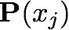
How Do We Calculate Site Likelihoods?
The Felsenstein Pruning Algorithm
Upon reaching the root of the tree, the conditional likelihood of each state is ‘weighted’ by the prior probability (stationary frequency) of the corresponding state, , to give the unconditional probability of the j^{th} site, .
π
i

Slide 171
How Do We Calculate Site Likelihoods?
The Felsenstein Pruning Algorithm
Upon reaching the root of the tree, the conditional likelihood of each state is ‘weighted’ by the prior probability (stationary frequency) of the corresponding state, , to give the unconditional probability of the j^{th} site, .
π
i

Slide 172
Approximating the Joint Posterior Probability Density using MCMC
The Metropolis-Hastings algorithm
1. Initialize the chain with some random values for all parameters, including the tree with branch lengths,
2. Select a parameter to update (alter) according to the proposal probabilities
3. Propose a new value, , for the selected parameter via the proposal mechanism:
each parameter has a prior probability distribution of a specific form (uniform, etc.)
each prior probability distribution has one or more proposal mechanisms
4. Calculate the probability of accepting the proposed change:
likelihood ratio
prior ratio
proposal ratio
Metropolis et al. (1953); Hastings (1970)

Slide 173
Approximating the Joint Posterior Probability Density using MCMC
The Metropolis-Hastings algorithm
1. Initialize the chain with some random values for all parameters, including the tree with branch lengths,
2. Select a parameter to update (alter) according to the proposal probabilities
3. Propose a new value, , for the selected parameter via the proposal mechanism:
each parameter has a prior probability distribution of a specific form (uniform, etc.)
each prior probability distribution has one or more proposal mechanisms
4. Calculate the probability of accepting the proposed change:
How do we calculate the prior probability for a given parameter value, ?
likelihood ratio
prior ratio
proposal ratio
Metropolis et al. (1953); Hastings (1970)

Slide 174
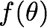
Approximating the Joint Posterior Probability Density using MCMC
Bayesian Inference
The prior for each parameter is specified
We can just look up the prior probability of a given parameter value .

Slide 175
Approximating the Joint Posterior Probability Density using MCMC
Bayesian Inference
The prior for each parameter is specified
We can just look up the prior probability of a given parameter value .

Slide 176
Approximating the Joint Posterior Probability Density using MCMC
Bayesian Inference
The prior for each parameter is specified
We can just look up the prior probability of a given parameter value .

Slide 177
Approximating the Joint Posterior Probability Density using MCMC
Bayesian Inference
The prior for each parameter is specified
We can just look up the prior probability of a given parameter value .

Slide 178
Approximating the Joint Posterior Probability Density using MCMC
The Metropolis-Hastings algorithm
1. Initialize the chain with some random values for all parameters, including the tree with branch lengths,
2. Select a parameter to update (alter) according to the proposal probabilities
3. Propose a new value, , for the selected parameter via the proposal mechanism:
each parameter has a prior probability distribution of a specific form (uniform, etc.)
each prior probability distribution has one or more proposal mechanisms
4. Calculate the probability of accepting the proposed change:
That means we compute R based only on the ratio of the product of the likelihood and the prior probability of the current and proposed parameter values,
likelihood ratio
prior ratio
proposal ratio
Metropolis et al. (1953); Hastings (1970)

Slide 179
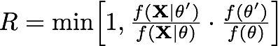
Approximating the Joint Posterior Probability Density using MCMC
The Metropolis-Hastings algorithm
1. Initialize the chain with some random values for all parameters, including the tree with branch lengths,
2. Select a parameter to update (alter) according to the proposal probabilities
3. Propose a new value, , for the selected parameter via the proposal mechanism:
each parameter has a prior probability distribution of a specific form (uniform, etc.)
each prior probability distribution has one or more proposal mechanisms
4. Calculate the probability of accepting the proposed change:
That means we compute R based only on the ratio of the product of the likelihood and the prior probability of the current and proposed parameter values,
likelihood ratio
prior ratio
Metropolis et al. (1953); Hastings (1970)

Slide 180
Approximating the Joint Posterior Probability Density using MCMC
The Metropolis-Hastings algorithm
1. Initialize the chain with some random values for all parameters, including the tree with branch lengths,
2. Select a parameter to update (alter) according to the proposal probabilities
3. Propose a new value, , for the selected parameter via the proposal mechanism:
each parameter has a prior probability distribution of a specific form (uniform, etc.)
each prior probability distribution has one or more proposal mechanisms
4. Calculate the probability of accepting the proposed change:
i.e., we decide how to explore the posterior probability density based on the ratio of the posterior probabilities of the current and proposed parameter values,
Metropolis et al. (1953); Hastings (1970)

Slide 181
Approximating the Joint Posterior Probability Density using MCMC
The Metropolis-Hastings algorithm
1. Initialize the chain with some random values for all parameters, including the tree with branch lengths,
2. Select a parameter to update (alter) according to the proposal probabilities
3. Propose a new value, , for the selected parameter via the proposal mechanism:
each parameter has a prior probability distribution of a specific form (uniform, etc.)
each prior probability distribution has one or more proposal mechanisms
4. Calculate the probability of accepting the proposed change:
i.e., we decide how to explore the posterior probability density based on the ratio of the posterior probabilities of the current and proposed parameter values,
posterior probability of proposed state
Metropolis et al. (1953); Hastings (1970)

Slide 182
Approximating the Joint Posterior Probability Density using MCMC
The Metropolis-Hastings algorithm
1. Initialize the chain with some random values for all parameters, including the tree with branch lengths,
2. Select a parameter to update (alter) according to the proposal probabilities
3. Propose a new value, , for the selected parameter via the proposal mechanism:
each parameter has a prior probability distribution of a specific form (uniform, etc.)
each prior probability distribution has one or more proposal mechanisms
4. Calculate the probability of accepting the proposed change:
i.e., we decide how to explore the posterior probability density based on the ratio of the posterior probabilities of the current and proposed parameter values,
posterior probability of proposed state
posterior probability of current state
Metropolis et al. (1953); Hastings (1970)

Slide 183
Approximating the Joint Posterior Probability Density using MCMC
The Metropolis-Hastings algorithm
1. Initialize the chain with some random values for all parameters, including the tree with branch lengths,
2. Select a parameter to update (alter) according to the proposal probabilities
3. Propose a new value, , for the selected parameter via the proposal mechanism:
each parameter has a prior probability distribution of a specific form (uniform, etc.)
each prior probability distribution has one or more proposal mechanisms
4. Calculate the probability of accepting the proposed change:
That means we can explore the posterior probability density without having to compute the marginal likelihood!!
likelihood function
prior probability
posterior probability
marginal likelihood
Metropolis et al. (1953); Hastings (1970)

Slide 184
Approximating the Joint Posterior Probability Density using MCMC
The Metropolis-Hastings algorithm
1. Initialize the chain with some random values for all parameters, including the tree with branch lengths,
2. Select a parameter to update (alter) according to the proposal probabilities
3. Propose a new value, , for the selected parameter via the proposal mechanism:
each parameter has a prior probability distribution of a specific form (uniform, etc.)
each prior probability distribution has one or more proposal mechanisms
4. Calculate the probability of accepting the proposed change, R
5. Generate a uniform random variable, U[0,1], accept if R > U
Metropolis et al. (1953); Hastings (1970)

Slide 185
Approximating the Joint Posterior Probability Density using MCMC
The Metropolis-Hastings algorithm
1. Initialize the chain with some random values for all parameters, including the tree with branch lengths,
2. Select a parameter to update (alter) according to the proposal probabilities
3. Propose a new value, , for the selected parameter via the proposal mechanism:
each parameter has a prior probability distribution of a specific form (uniform, etc.)
each prior probability distribution has one or more proposal mechanisms
4. Calculate the probability of accepting the proposed change, R
5. Generate a uniform random variable, U[0,1], accept if R > U
6. Repeat steps 2–5 an ‘adequate’ number of times
Metropolis et al. (1953); Hastings (1970)

Slide 186
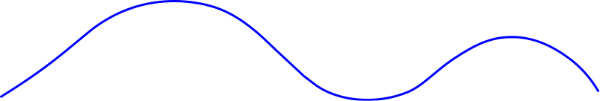
Approximating the Joint Posterior Probability Density using MCMC
The Metropolis-Hastings algorithm
Probability
= 0.05

Slide 187
Approximating the Joint Posterior Probability Density using MCMC
The Metropolis-Hastings algorithm
= 0.1
Probability
= 0.05

Slide 188
Approximating the Joint Posterior Probability Density using MCMC
The Metropolis-Hastings algorithm
= 0.1
Probability
= 0.05
likelihood ratio
prior ratio
proposal ratio

Slide 189
Approximating the Joint Posterior Probability Density using MCMC
The Metropolis-Hastings algorithm
= 0.1
Probability
= 0.05
posterior ratio
proposal ratio

Slide 190
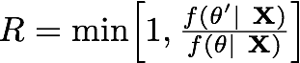
Approximating the Joint Posterior Probability Density using MCMC
The Metropolis-Hastings algorithm
= 0.1
Probability
= 0.05
posterior ratio

Slide 191
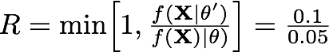
Approximating the Joint Posterior Probability Density using MCMC
The Metropolis-Hastings algorithm
= 0.1
Probability
= 0.05

Slide 192
Approximating the Joint Posterior Probability Density using MCMC
The Metropolis-Hastings algorithm
= 0.1
Probability
= 0.05

Slide 193
Approximating the Joint Posterior Probability Density using MCMC
The Metropolis-Hastings algorithm
= 0.1
Probability
= 0.05
Probability
0
U
1

Slide 194
Approximating the Joint Posterior Probability Density using MCMC
The Metropolis-Hastings algorithm
= 0.1
Probability
= 0.05
Probability
0
U
1

Slide 195
Approximating the Joint Posterior Probability Density using MCMC
The Metropolis-Hastings algorithm
= 0.1
Probability
= 0.05
Probability
Accept
0
U
1

Slide 196
Approximating the Joint Posterior Probability Density using MCMC
The Metropolis-Hastings algorithm
= 0.1
Probability
Probability
Accept
0
U
1

Slide 197
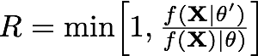
Approximating the Joint Posterior Probability Density using MCMC
The Metropolis-Hastings algorithm
= 0.1
Probability
Probability
0
U
1

Slide 198
Approximating the Joint Posterior Probability Density using MCMC
The Metropolis-Hastings algorithm
= 0.1
Probability
= 0.05
Probability
0
U
1

Slide 199
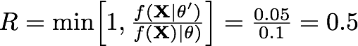
Approximating the Joint Posterior Probability Density using MCMC
The Metropolis-Hastings algorithm
= 0.1
Probability
= 0.05
Probability
0
U
1

Slide 200
Approximating the Joint Posterior Probability Density using MCMC
The Metropolis-Hastings algorithm
= 0.1
Probability
= 0.05
Probability
0
U
1

Slide 201
Approximating the Joint Posterior Probability Density using MCMC
The Metropolis-Hastings algorithm
= 0.1
Probability
= 0.05
Probability
0
U
1

Slide 202
Approximating the Joint Posterior Probability Density using MCMC
The Metropolis-Hastings algorithm
= 0.1
Probability
= 0.05
Probability
Accept
Reject
0
U
1

Slide 203
Approximating the Joint Posterior Probability Density using MCMC
The Metropolis-Hastings algorithm
= 0.1
Probability
Probability
0
U
1

Slide 204
Approximating the Joint Posterior Probability Density using MCMC
The Metropolis-Hastings algorithm
= 0.1
Probability
= 0.025
Probability
0
U
1

Slide 205
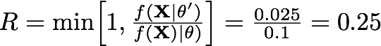
Approximating the Joint Posterior Probability Density using MCMC
The Metropolis-Hastings algorithm
= 0.1
Probability
= 0.025
Probability
0
U
1

Slide 206
Approximating the Joint Posterior Probability Density using MCMC
The Metropolis-Hastings algorithm
= 0.1
Probability
= 0.025
Probability
0
U
1

Slide 207
Approximating the Joint Posterior Probability Density using MCMC
The Metropolis-Hastings algorithm
= 0.1
Probability
= 0.025
Probability
0
U
1

Slide 208
Approximating the Joint Posterior Probability Density using MCMC
The Metropolis-Hastings algorithm
= 0.1
Probability
= 0.025
Probability
Accept
Reject
0
U
1

Slide 209

Approximating the Joint Posterior Probability Density using MCMC
iMCMC demonstration
John Huelsenbeck (inspired by MCMC Robot by Paul Lewis)

Slide 210
Bayesian Inference of Phylogeny (on one slide)
I. Data
Assume an alignment, X, of N sites for S species:
II. Phylogenetic model parameters
IV. Priors on parameters
1. Tree
topology
~Uniform
branch lengths
~Dirichlet (1,...,1)
2. Model of character change
relative substitution rates
~Dirichlet (1,1,1,1,1,1)
stationary frequencies
~Dirichlet (1,1,1,1)
III. Phylogenetic likelihood function
V. Posterior Probability

Slide 211
Bayesian Inference of Phylogeny (on one slide)
I. Data
Assume an alignment, X, of N sites for S species:
II. Phylogenetic model parameters
IV. Priors on parameters
1. Tree
topology
~Uniform
branch lengths
~Dirichlet (1,...,1)
2. Model of character change
relative substitution rates
~Dirichlet (1,1,1,1,1,1)
stationary frequencies
~Dirichlet (1,1,1,1)
III. Phylogenetic likelihood function
V. Posterior Probability

Slide 212
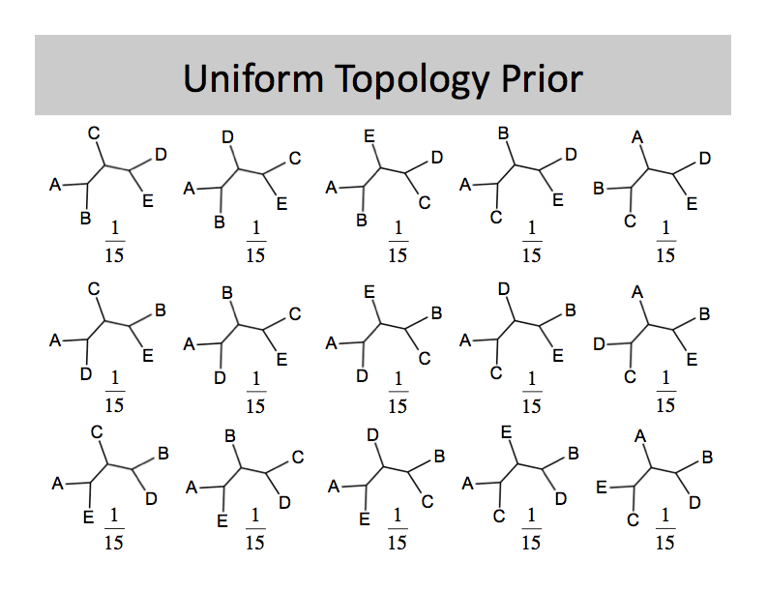
Approximating the Joint Posterior Probability Density using MCMC
Discrete-uniform prior on topologies

Slide 213
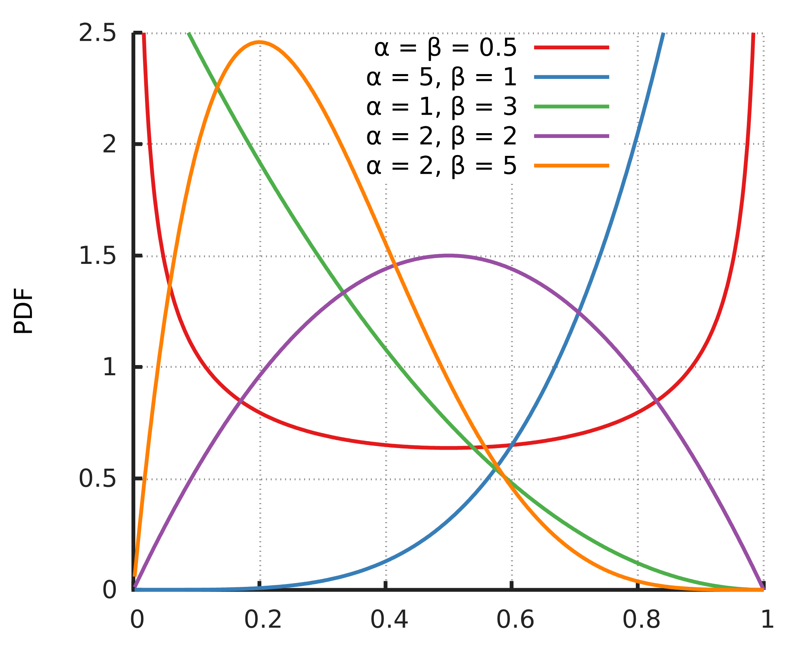
Approximating the Joint Posterior Probability Density using MCMC
Beta prior

Slide 214
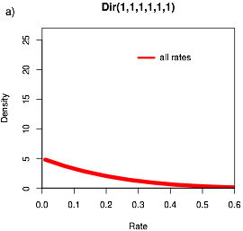
Approximating the Joint Posterior Probability Density using MCMC
Dirichlet prior
Generalization of the beta often used for proportions

Slide 215
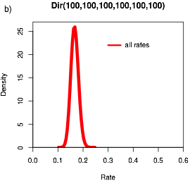
Approximating the Joint Posterior Probability Density using MCMC
Dirichlet prior
Generalization of the beta often used for proportions

Slide 216
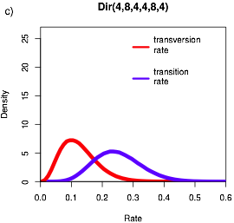
Approximating the Joint Posterior Probability Density using MCMC
Dirichlet prior
Generalization of the beta often used for proportions

Slide 217
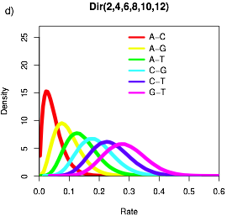
Approximating the Joint Posterior Probability Density using MCMC
Dirichlet prior
Generalization of the beta often used for proportions

Slide 218


Approximating the Joint Posterior Probability Density using MCMC
Exponential priors
Often used for branch lengths with rate parameter and mean
Probability density
Branch length

Slide 219

Approximating the Joint Posterior Probability Density using MCMC
Gamma prior
May be used for tree length (sum of branch lengths)
Probability density
Tree length

Slide 220
Approximating the Joint Posterior Probability Density using MCMC
The Metropolis-Hastings algorithm
1. Initialize the chain with some random values for all parameters, including the tree with branch lengths, .
2. Select a parameter to update (alter) according to the proposal probabilities
3. Propose a new value, , for the selected parameter via the proposal mechanism:
each parameter has a prior probability distribution of a specific form (uniform, etc.)
each prior probability distribution has one or more proposal mechanisms
4. Calculate the probability of accepting the proposed change:
5. Generate a uniform random variable, U[0,1], accept if R > U
6. Repeat steps 2–5 an ‘adequate’ number of times
Metropolis et al. (1953); Hastings (1970)

Slide 221
Approximating the Joint Posterior Probability Density using MCMC
Scale of the tuning parameter is important for MCMC efficiency
John Huelsenbeck (inspired by MCMC Robot by Paul Lewis)

Slide 222

Approximating the Joint Posterior Probability Density using MCMC
Dirichlet proposal mechanism
current parameter value
Propose a new value for a parameter with a Dirichlet prior probability density
the proposal density is controlled by the tuning parameter,
when is large, smaller changes will be proposed
when is small, larger changes will be proposed
pi ~ dnDirichlet(pi_prior)
moves[++mi] = mvSimplexElementScale(pi, alpha=10.0, tune=true, weight=2.0)

Slide 223

Approximating the Joint Posterior Probability Density using MCMC
Sliding-window proposal mechanism
current parameter value
Propose a new value for a parameter with a uniform prior probability density
the proposal density is controlled by the tuning parameter,
when is large, larger changes will be proposed
when is small, smaller changes will be proposed
epsilon ~ dnUnif( epsilon_prior_min, epsilon_prior_max )
moves[++mi] = mvSlide(epsilon, delta=0.8, tune=true, weight=3.0)

Slide 224


Approximating the Joint Posterior Probability Density using MCMC
Multiplier proposal mechanism
current parameter value
Propose a new value for a parameter with a exponential prior probability density
the proposal density is controlled by the tuning parameter,
when is large, larger changes will be proposed
when is small, smaller changes will be proposed
Equivalent to sliding-window proposal with log-transformed x axis
Works well when changes to small parameter values have a larger impact on probability of data than changes in large parameter values
br_lens[i] ~ dnExponential(10.0)
moves[++mi] = mvScale(br_lens[i],lambda=1,tune=true,weight=1)

Slide 225

Approximating the Joint Posterior Probability Density using MCMC
Robot Squadron!!
Metropolis et al. (1953); Hastings (1970)

Slide 226
Approximating the Joint Posterior Probability Density using Metropolis-Coupled MCMC
The MC³ algorithm
1. Initialize N independent M-H MCMC chains with random values for all parameters.

Slide 227




Approximating the Joint Posterior Probability Density using Metropolis-Coupled MCMC
The MC³ algorithm
1. Initialize N independent M-H MCMC chains with random values for all parameters.
2. The chains are incrementally heated, such that the first chain is cold (unmodified).
posterior of chain i is raised to a power, : the heat of chain i = 1/(1 + iT)
 | temperature
chain | 0.25 | 0.20 | 0.15 | 0.10
0 | 1.00 | 1.00 | 1.00 | 1.00
1 | 0.80 | 0.83 | 0.87 | 0.91
2 | 0.67 | 0.71 | 0.77 | 0.83
3 | 0.57 | 0.63 | 0.69 | 0.77

Slide 228
Approximating the Joint Posterior Probability Density using Metropolis-Coupled MCMC
The MC³ algorithm
1. Initialize N independent M-H MCMC chains with random values for all parameters.
2. The chains are incrementally heated, such that the first chain is cold (unmodified).
posterior of chain i is raised to a power, : the heat of chain i = 1/(1 + iT)
 | temperature
chain | 0.25 | 0.20 | 0.15 | 0.10
0 | 1.00 | 1.00 | 1.00 | 1.00
1 | 0.80 | 0.83 | 0.87 | 0.91
2 | 0.67 | 0.71 | 0.77 | 0.83
3 | 0.57 | 0.63 | 0.69 | 0.77

Slide 229
Approximating the Joint Posterior Probability Density using Metropolis-Coupled MCMC
The MC³ algorithm
1. Initialize N independent M-H MCMC chains with random values for all parameters.
2. The chains are incrementally heated, such that the first chain is cold (unmodified).
posterior of chain i is raised to a power, : the heat of chain i = 1/(1 + iT)
 | temperature
chain | 0.25 | 0.20 | 0.15 | 0.10
0 | 1.00 | 1.00 | 1.00 | 1.00
1 | 0.80 | 0.83 | 0.87 | 0.91
2 | 0.67 | 0.71 | 0.77 | 0.83
3 | 0.57 | 0.63 | 0.69 | 0.77

Slide 230
Approximating the Joint Posterior Probability Density using Metropolis-Coupled MCMC
The MC³ algorithm
1. Initialize N independent M-H MCMC chains with random values for all parameters.
2. The chains are incrementally heated, such that the first chain is cold (unmodified).
posterior of chain i is raised to a power, : the heat of chain i = 1/(1 + iT)
 | temperature
chain | 0.25 | 0.20 | 0.15 | 0.10
0 | 1.00 | 1.00 | 1.00 | 1.00
1 | 0.80 | 0.83 | 0.87 | 0.91
2 | 0.67 | 0.71 | 0.77 | 0.83
3 | 0.57 | 0.63 | 0.69 | 0.77

Slide 231
Approximating the Joint Posterior Probability Density using Metropolis-Coupled MCMC
The MC³ algorithm
1. Initialize N independent M-H MCMC chains with random values for all parameters.
2. The chains are incrementally heated, such that the first chain is cold (unmodified).
posterior of chain i is raised to a power, : the heat of chain i = 1/(1 + iT)
 | temperature
chain | 0.25 | 0.20 | 0.15 | 0.10
0 | 1.00 | 1.00 | 1.00 | 1.00
1 | 0.80 | 0.83 | 0.87 | 0.91
2 | 0.67 | 0.71 | 0.77 | 0.83
3 | 0.57 | 0.63 | 0.69 | 0.77

Slide 232

Approximating the Joint Posterior Probability Density using Metropolis-Coupled MCMC
The MC³ algorithm
1. Initialize N independent M-H MCMC chains with random values for all parameters.
2. The chains are incrementally heated, such that the first chain is cold (unmodified).
posterior of chain i is raised to a power, : the heat of chain i = 1/(1 + iT)
 | temperature
chain | 0.25 | 0.20 | 0.15 | 0.10
0 | 1.00 | 1.00 | 1.00 | 1.00
1 | 0.80 | 0.83 | 0.87 | 0.91
2 | 0.67 | 0.71 | 0.77 | 0.83
3 | 0.57 | 0.63 | 0.69 | 0.77
the incremental heating successively ‘flattens’ the posterior visited by each chain by making the acceptance probability of the i^{th} chain more ‘permissive’:

Slide 233
Approximating the Joint Posterior Probability Density using Metropolis-Coupled MCMC
The MC³ algorithm
1. Initialize N independent M-H MCMC chains with random values for all parameters.
2. The chains are incrementally heated, such that the first chain is cold (unmodified).
posterior of chain i is raised to a power, : the heat of chain i = 1/(1 + iT)
 | temperature
chain | 0.25 | 0.20 | 0.15 | 0.10
0 | 1.00 | 1.00 | 1.00 | 1.00
1 | 0.80 | 0.83 | 0.87 | 0.91
2 | 0.67 | 0.71 | 0.77 | 0.83
3 | 0.57 | 0.63 | 0.69 | 0.77
the incremental heating successively ‘flattens’ the posterior visited by each chain by making the acceptance probability of the i^{th} chain more ‘permissive’:
this allows heated chains to more readily traverse regions of low probability.

Slide 234
Approximating the Joint Posterior Probability Density using Metropolis-Coupled MCMC
The MC³ algorithm
1. Initialize N independent M-H MCMC chains with random values for all parameters.
2. The chains are incrementally heated, such that the first chain is cold (unmodified).
posterior of chain i is raised to a power, : the heat of chain i = 1/(1 + iT)
 | temperature
chain | 0.25 | 0.20 | 0.15 | 0.10
0 | 1.00 | 1.00 | 1.00 | 1.00
1 | 0.80 | 0.83 | 0.87 | 0.91
2 | 0.67 | 0.71 | 0.77 | 0.83
3 | 0.57 | 0.63 | 0.69 | 0.77
the incremental heating successively ‘flattens’ the posterior visited by each chain by making the acceptance probability of the i^{th} chain more ‘permissive’:
this allows heated chains to more readily traverse regions of low probability.
the degree of incremental heating is controlled by the temperature parameter, T.

Slide 235
Approximating the Joint Posterior Probability Density using Metropolis-Coupled MCMC
The MC³ algorithm
1. Initialize N independent M-H MCMC chains with random values for all parameters.
2. The chains are incrementally heated, such that the first chain is cold (unmodified).
posterior of chain i is raised to a power, : the heat of chain i = 1/(1 + iT)
 | temperature
chain | 0.25 | 0.20 | 0.15 | 0.10
0 | 1.00 | 1.00 | 1.00 | 1.00
1 | 0.80 | 0.83 | 0.87 | 0.91
2 | 0.67 | 0.71 | 0.77 | 0.83
3 | 0.57 | 0.63 | 0.69 | 0.77
the incremental heating successively ‘flattens’ the posterior visited by each chain by making the acceptance probability of the i^{th} chain more ‘permissive’:
this allows heated chains to more readily traverse regions of low probability.
the degree of incremental heating is controlled by the temperature parameter, T.

Slide 236
Approximating the Joint Posterior Probability Density using Metropolis-Coupled MCMC
The MC³ algorithm
1. Initialize N independent M-H MCMC chains with random values for all parameters.
2. The chains are incrementally heated, such that the first chain is cold (unmodified).
posterior of chain i is raised to a power, : the heat of chain i = 1/(1 + iT)
 | temperature
chain | 0.25 | 0.20 | 0.15 | 0.10
0 | 1.00 | 1.00 | 1.00 | 1.00
1 | 0.80 | 0.83 | 0.87 | 0.91
2 | 0.67 | 0.71 | 0.77 | 0.83
3 | 0.57 | 0.63 | 0.69 | 0.77
the incremental heating successively ‘flattens’ the posterior visited by each chain by making the acceptance probability of the i^{th} chain more ‘permissive’:
this allows heated chains to more readily traverse regions of low probability.
the degree of incremental heating is controlled by the temperature parameter, T.

Slide 237
Approximating the Joint Posterior Probability Density using Metropolis-Coupled MCMC
The MC³ algorithm
1. Initialize N independent M-H MCMC chains with random values for all parameters.
2. The chains are incrementally heated, such that the first chain is cold (unmodified).
posterior of chain i is raised to a power, : the heat of chain i = 1/(1 + iT)
 | temperature
chain | 0.25 | 0.20 | 0.15 | 0.10
0 | 1.00 | 1.00 | 1.00 | 1.00
1 | 0.80 | 0.83 | 0.87 | 0.91
2 | 0.67 | 0.71 | 0.77 | 0.83
3 | 0.57 | 0.63 | 0.69 | 0.77
the incremental heating successively ‘flattens’ the posterior visited by each chain by making the acceptance probability of the i^{th} chain more ‘permissive’:
this allows heated chains to more readily traverse regions of low probability.
the degree of incremental heating is controlled by the temperature parameter, T.

Slide 238
Approximating the Joint Posterior Probability Density using Metropolis-Coupled MCMC
The MC³ algorithm
1. Initialize N independent M-H MCMC chains with random values for all parameters.
2. The chains are incrementally heated, such that the first chain is cold (unmodified).
posterior of chain i is raised to a power, : the heat of chain i = 1/(1 + iT)
 | temperature
chain | 0.25 | 0.20 | 0.15 | 0.10
0 | 1.00 | 1.00 | 1.00 | 1.00
1 | 0.80 | 0.83 | 0.87 | 0.91
2 | 0.67 | 0.71 | 0.77 | 0.83
3 | 0.57 | 0.63 | 0.69 | 0.77
cold chain
the incremental heating successively ‘flattens’ the posterior visited by each chain by making the acceptance probability of the i^{th} chain more ‘permissive’:
this allows heated chains to more readily traverse regions of low probability.
the degree of incremental heating is controlled by the temperature parameter, T.
samples are only collected by the ‘cold’ chain (i.e., the undistorted posterior).

Slide 239
Approximating the Joint Posterior Probability Density using Metropolis-Coupled MCMC
The MC³ algorithm
1. Initialize N independent M-H MCMC chains with random values for all parameters.
2. The chains are incrementally heated, such that the first chain is cold (unmodified).
posterior of chain i is raised to a power, : the heat of chain i = 1/(1 + iT)
the cold chain samples the true posterior, whereas the heated chains sample successively ‘flattened’ distortions of the posterior
chain 0 ( = 1.00)

Slide 240

Approximating the Joint Posterior Probability Density using Metropolis-Coupled MCMC
The MC³ algorithm
1. Initialize N independent M-H MCMC chains with random values for all parameters.
2. The chains are incrementally heated, such that the first chain is cold (unmodified).
posterior of chain i is raised to a power, : the heat of chain i = 1/(1 + iT)
the cold chain samples the true posterior, whereas the heated chains sample successively ‘flattened’ distortions of the posterior
chain 0 ( = 1.00)
chain 1 ( = 0.83)

Slide 241

Approximating the Joint Posterior Probability Density using Metropolis-Coupled MCMC
The MC³ algorithm
1. Initialize N independent M-H MCMC chains with random values for all parameters.
2. The chains are incrementally heated, such that the first chain is cold (unmodified).
posterior of chain i is raised to a power, : the heat of chain i = 1/(1 + iT)
the cold chain samples the true posterior, whereas the heated chains sample successively ‘flattened’ distortions of the posterior
chain 0 ( = 1.00)
chain 1 ( = 0.83)
chain 2 ( = 0.71)

Slide 242

Approximating the Joint Posterior Probability Density using Metropolis-Coupled MCMC
The MC³ algorithm
1. Initialize N independent M-H MCMC chains with random values for all parameters.
2. The chains are incrementally heated, such that the first chain is cold (unmodified).
posterior of chain i is raised to a power, : the heat of chain i = 1/(1 + iT)
the cold chain samples the true posterior, whereas the heated chains sample successively ‘flattened’ distortions of the posterior
chain 0 ( = 1.00)
chain 1 ( = 0.83)
chain 2 ( = 0.71)
chain 3 ( = 0.63)

Slide 243
Approximating the Joint Posterior Probability Density using Metropolis-Coupled MCMC
The MC³ algorithm
1. Initialize N independent M-H MCMC chains with random values for all parameters.
2. The chains are incrementally heated, such that the first chain is cold (unmodified).
posterior of chain i is raised to a power, : the heat of chain i = 1/(1 + iT)
the cold chain samples the true posterior, whereas the heated chains sample successively ‘flattened’ distortions of the posterior
heated chains to more readily traverse regions of low probability
chain 0 ( = 1.00)
chain 1 ( = 0.83)
chain 2 ( = 0.71)
chain 3 ( = 0.63)

Slide 244
Approximating the Joint Posterior Probability Density using Metropolis-Coupled MCMC
The MC³ algorithm
1. Initialize N independent M-H MCMC chains with random values for all parameters.
2. The chains are incrementally heated, such that the first chain is cold (unmodified).
posterior of chain i is raised to a power, : the heat of chain i = 1/(1 + iT)
the cold chain samples the true posterior, whereas the heated chains sample successively ‘flattened’ distortions of the posterior
heated chains to more readily traverse regions of low probability
chain 0 ( = 1.00)
chain 1 ( = 0.83)
chain 2 ( = 0.71)
chain 3 ( = 0.63)

Slide 245
Approximating the Joint Posterior Probability Density using Metropolis-Coupled MCMC
The MC³ algorithm
1. Initialize N independent M-H MCMC chains with random values for all parameters.
2. The chains are incrementally heated, such that the first chain is cold (unmodified).
3. At prescribed intervals, two chains are randomly selected to swap.
chain 0 ( = 1.00)
chain 1 ( = 0.83)
chain 2 ( = 0.71)
chain 3 ( = 0.63)

Slide 246

Approximating the Joint Posterior Probability Density using Metropolis-Coupled MCMC
The MC³ algorithm
1. Initialize N independent M-H MCMC chains with random values for all parameters.
2. The chains are incrementally heated, such that the first chain is cold (unmodified).
3. At prescribed intervals, two chains are randomly selected to swap.
we compute the acceptance probability of swapping the two chains.
chain 0 ( = 1.00)
chain 1 ( = 0.83)
chain 2 ( = 0.71)
chain 3 ( = 0.63)

Slide 247
Approximating the Joint Posterior Probability Density using Metropolis-Coupled MCMC
The MC³ algorithm
1. Initialize N independent M-H MCMC chains with random values for all parameters.
2. The chains are incrementally heated, such that the first chain is cold (unmodified).
3. At prescribed intervals, two chains are randomly selected to swap.
we compute the acceptance probability of swapping the two chains.
if accepted, the chains swap positions (and in computer memory)
chain 0 ( = 1.00)
chain 1 ( = 0.83)
chain 2 ( = 0.71)
chain 3 ( = 0.63)

Slide 248
Approximating the Joint Posterior Probability Density using Metropolis-Coupled MCMC
The MC³ algorithm
1. Initialize N independent M-H MCMC chains with random values for all parameters.
2. The chains are incrementally heated, such that the first chain is cold (unmodified).
3. At prescribed intervals, two chains are randomly selected to swap.
4. Only samples from the cold chain are used to approximate the posterior.
chain 0 ( = 1.00)
chain 1 ( = 0.83)
chain 2 ( = 0.71)
chain 3 ( = 0.63)

Slide 249
Approximating the Joint Posterior Probability Density using Metropolis-Coupled MCMC
MC³ demo
John Huelsenbeck (inspired by MCMC Robot by Paul Lewis)

Slide 250
Outline
I. Introduction to Bayesian inference
Becoming fascinated with posteriors:
Deriving Bayes theorem
Two non-phylogenetic examples
Bayesian inference of phylogeny
II. The Bayesian hard sell
What’s the deal with priors?
Learning to embrace your inner Bayesian
III. Numerical algorithms for Bayesian inference
Markov-chain Monte Carlo (MCMC)
Metropolis-Hastings algorithm
Metropolis-Coupled algorithm
Summarizing posterior samples

Slide 251
Outline
I. Introduction to Bayesian inference
Becoming fascinated with posteriors:
Deriving Bayes theorem
Two non-phylogenetic examples
Bayesian inference of phylogeny
II. The Bayesian hard sell
What’s the deal with priors?
Learning to embrace your inner Bayesian
III. Numerical algorithms for Bayesian inference
Markov-chain Monte Carlo (MCMC)
Metropolis-Hastings algorithm
Metropolis-Coupled algorithm
Summarizing posterior samples

Slide 252
Approximating the Joint Posterior Probability Density using MCMC
Samples from the MCMC simulation approximate the joint posterior
The frequency of sampled parameter values provides a valid estimate of the posterior probability of that parameter

Slide 253
Approximating the Joint Posterior Probability Density using MCMC
Samples from the MCMC simulation approximate the joint posterior
The frequency of sampled parameter values provides a valid estimate of the posterior probability of that parameter
e.g., the frequency of a sampled clade provides an estimate of its nodal probability

Slide 254
Approximating the Joint Posterior Probability Density using MCMC
Samples from the MCMC simulation approximate the joint posterior
The frequency of sampled parameter values provides a valid estimate of the posterior probability of that parameter
e.g., the frequency of a sampled clade provides an estimate of its nodal probability
We can query the joint posterior with respect to any individual parameter of interest: the marginal posterior probability

Slide 255

Approximating the Joint Posterior Probability Density using MCMC
Samples from the MCMC simulation approximate the joint posterior
Each row in our log file—with values of all model parameters—is a sample from the joint posterior probability density.

Slide 256
Approximating the Joint Posterior Probability Density using MCMC
Samples from the MCMC simulation approximate the joint posterior
Each row in our log file—with values of all model parameters—is a sample from the joint posterior probability density.

Slide 257
Approximating the Joint Posterior Probability Density using MCMC
Samples from the MCMC simulation approximate the joint posterior
Each row in our log file—with values of all model parameters—is a sample from the joint posterior probability density.

Slide 258
Approximating the Joint Posterior Probability Density using MCMC
Samples from the MCMC simulation approximate the joint posterior
Each column in our log file—with values for a single model parameter—is a sample from the marginal posterior probability density.

Slide 259
Approximating the Joint Posterior Probability Density using MCMC
Samples from the MCMC simulation approximate the joint posterior
We can query the joint distribution marginally with respect to any parameter.

Slide 260
Approximating the Joint Posterior Probability Density using MCMC
Samples from the MCMC simulation approximate the joint posterior
We can do this by simply constructed a histogram for any column in the file this provides an estimate of its marginal posterior probability density

Slide 261

Approximating the Joint Posterior Probability Density using MCMC
Samples from the MCMC simulation approximate the joint posterior
We can do this by simply constructed a histogram for any column in the file this provides an estimate of its marginal posterior probability density

Slide 262

Approximating the Joint Posterior Probability Density using MCMC
Samples from the MCMC simulation approximate the joint posterior
We can easily summarize aspects of the marginal posterior probability density: e.g., to summarize the 95% credible interval.

Slide 263

Approximating the Joint Posterior Probability Density using MCMC
Samples from the MCMC simulation approximate the joint posterior
We can easily summarize aspects of the marginal posterior probability density: e.g., or the probability within some arbitrary interval of interest (0.6–0.8).

Slide 264

Approximating the Joint Posterior Probability Density using MCMC
Samples from the MCMC simulation approximate the joint posterior
We can easily summarize aspects of the marginal posterior probability density: e.g., or we can summarize the highest posterior density (HPD) interval.
0
1
2
3
4
0.0
0.2
0.4
0.6
0.8
1.0

Slide 265
Approximating the Joint Posterior Probability Density using MCMC
Samples from the MCMC simulation approximate the joint posterior
We can easily summarize aspects of the marginal posterior probability density: e.g., or we can summarize the highest posterior density (HPD) interval.
0
1
2
3
4
0.0
0.2
0.4
0.6
0.8
1.0

Slide 266
Approximating the Joint Posterior Probability Density using MCMC
Samples from the MCMC simulation approximate the joint posterior
We can easily summarize aspects of the marginal posterior probability density: e.g., or we can summarize the highest posterior density (HPD) interval.
0
1
2
3
4
0.0
0.2
0.4
0.6
0.8
1.0

Slide 267
Approximating the Joint Posterior Probability Density using MCMC
Samples from the MCMC simulation approximate the joint posterior
We can easily summarize aspects of the marginal posterior probability density: e.g., or we can summarize the highest posterior density (HPD) interval.
0
1
2
3
4
0.0
0.2
0.4
0.6
0.8
1.0

Slide 268
Approximating the Joint Posterior Probability Density using MCMC
MCMC in theory and practice
MCMC in theory...
an appropriately constructed and adequately run chain is guaranteed to provide an arbitrarily precise description of the joint stationary density

Slide 269
Approximating the Joint Posterior Probability Density using MCMC
MCMC in theory and practice
MCMC in theory...
an appropriately constructed and adequately run chain is guaranteed to provide an arbitrarily precise description of the joint stationary density
MCMC in practice...
although a given sampler may work well in most cases, all samplers will fail in some cases, and is not guaranteed to work for any particular case

Slide 270
Statistical Estimation of Phylogeny: An Outline
Inference Method
Data
Model
Parameter
Estimates
sequence
alignment
tree with
branch lengths
maximum likelihood
phylogeny & other model parameters
substitution
model
Bayesian inference

Slide 271
Statistical Estimation of Phylogeny: An Outline
Inference Method
Data
Model
Parameter
Estimates
sequence
alignment
tree with
branch lengths
maximum likelihood
phylogeny & other model parameters
substitution
model
Bayesian inference
MCMC diagnosis
Next time!!

